Slide 1

Ways of taking input from user
Prepared by : Dimple Bohra

Slide 2
Ways of taking input from user
Through command line
Using Scanner class
Using BufferedReader class

Slide 3
Packages
It is a collection of related classes, which have pre-defined methods, variables and interfaces that a programmer can use in his/her application.
The classes of package contain built-in methods that can be readily used by programmer.
Java contains many packages which in turn contain many library classes.

Slide 4
Frequent packages and their commonly used members
java.io : contains members that help in system I/O.
BufferedReader, BufferedWriter, DataInputStream, DataOutputStream, IOException
java.lang : contains members that are fundamental to the design of the Java language. This package is automatically imported in java program. It contains wrapper classes e.g. Integer, String, Boolean, Math, System etc.
ArrayIndexOutOfBoundsException, NullPointerException

Slide 5
Frequent packages and their commonly used members
java.util : contains some utility members such as:
StringTokenizer, Scanner, Calender, Date

Slide 6
Input through command line
class CommandLineExample{
public static void main(String args[]){
System.out.println("Your first argument is: "+args[0]);
}
}
C:\programs>javac CommandLineExample.java
C:\programs>java CommandLineExample Hello
class A{
public static void main(String args[]){
for(int i=0;i<args.length;i++)
System.out.println(args[i]);
}}
C:\programs>javac A.java
C:\programs>java A Happy Ganesh Chaturthi
Notes:
The java command-line argument is an argument i.e. passed at the time of running the java program.
The arguments passed from the console can be received in the java program and it can be used as an input.
So, it provides a convenient way to check the behavior of the program for the different values. You can pass N (1,2,3 and so on) numbers of arguments from the command prompt.

Slide 7
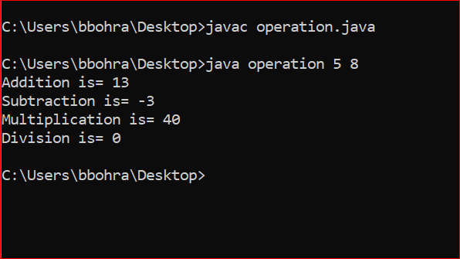
Input through command line
class operation
{
public static void main(String args[])
{
int a,b;
a=Integer.parseInt(args[0]);
b=Integer.parseInt(args[1]);
System.out.println("Addition is= "+(a+b));
System.out.println("Subtraction is= "+(a-b));
System.out.println("Multiplication is= "+(a*b));
System.out.println("Division is= "+(a/b));
}
}

Slide 8
Input using Scanner class
The Scanner class is used to get user input, and it is found in the java.util package.
The Java Scanner class breaks the input into tokens using a delimiter which is whitespace by default.
The Java Scanner class provides nextXXX() methods to return the type of value such as nextInt(), nextByte(), nextShort(), next(), nextLine(), nextDouble(), nextFloat(), nextBoolean(), etc.
To get a single character from the scanner, you can call next().charAt(0) method which returns a single character.

Slide 9
Input using Scanner class
To use Scanner class, we need to create an instance/object of Scanner class.
To create an object of Scanner class, we usually pass the predefined object System.in, which represents the standard input stream.
Syntax of creating object:
classname obj = new classname( );
For Scanner class to get input from user:
Scanner in = new Scanner(System.in);

Slide 10
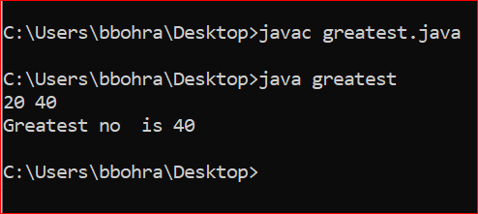
Input using Scanner class
import java.util.*;
class greatest
{
public static void main(String args[])
{ Scanner sc = new Scanner(System.in);
int a,b;
a=sc.nextInt();
b=sc.nextInt();
if(a>b)
{System.out.println("Greatest no is "+a);}
else
{System.out.println("Greatest no is "+b);}
}
}

Slide 11
Input using bufferedreader class
The BufferedReader class of Java is used to read the stream of characters from the specified source (character-input stream).
This class provides a method known as readLine() which reads and returns the next line from the source and returns it in String format.
The BufferedReader class doesn’t provide any direct method to read an integer from the user you need to rely on the readLine() method to read integers too. i.e. Initially you need to read the integers in string format.
The parseInt() method of the Integer class accepts a String value, parses it as a signed decimal integer and returns it.

Slide 12
Input using bufferedreader class
How to create object of BufferedReader class:
InputStreamReader r=new InputStreamReader(System.in); BufferedReader br=new BufferedReader(r);
These two statements can be combined and can be written as:
BufferedReader br = new BufferedReader(new InputStreamReader(System.in));
Notes:
we are connecting the BufferedReader stream with the InputStreamReader stream for reading the line by line data from the keyboard.

Slide 13
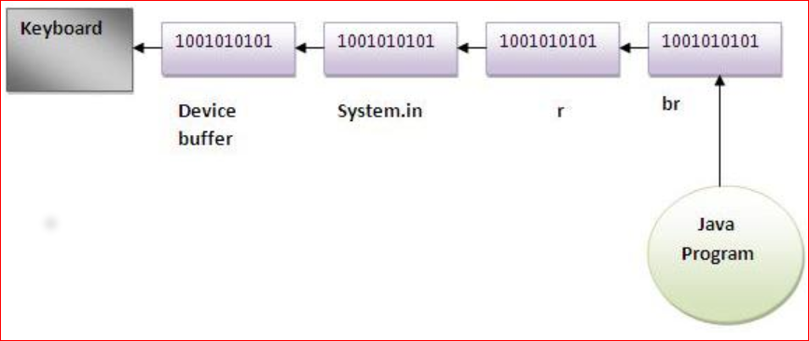

Slide 14
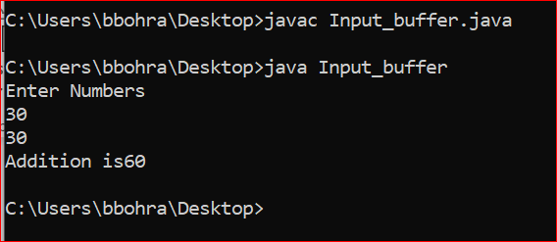
Input using bufferedreader class
import java.io.*;
class fibo
{ public static void main(String args[]) throws IOException
{
int a,b,c;
System.out.println("Enter Numbers");
BufferedReader br = new BufferedReader(new InputStreamReader(System.in));
a= Integer.parseInt(br.readLine());
b= Integer.parseInt(br.readLine());
c=a+b;
System.out.println(“Addition is“+c);
}
}

Slide 15
Thank you!!

